Slide 1




C# – Introduction
C# Basic Syntax, Visual Studio, Console Input / Output
Programming Fundamentals
SoftUni Team
Technical Trainers
Software University
http://softuni.bg

Slide 2


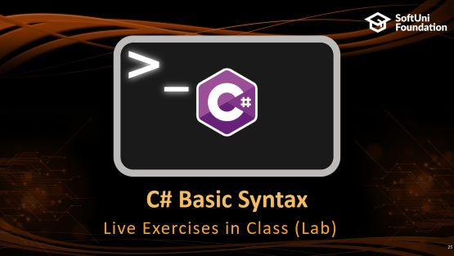

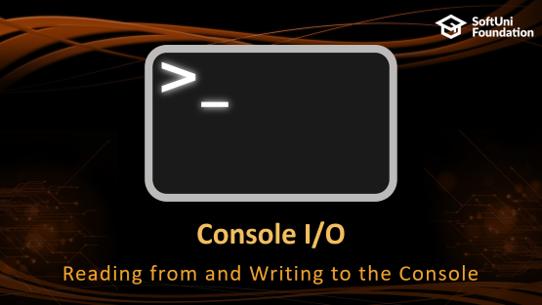
Table of Contents

Slide 3
Have a Question?
sli.do #fund-softuni

Slide 4

Introduction and Basic Syntax

Slide 5
C# – Introduction
C# is modern, flexible, general-purpose programming language
Object-oriented by nature, statically-typed, compiled
Runs on .NET Framework / .NET Core
static void Main()
{
Console.Write("What's your name? ");
var name = Console.ReadLine();
Console.WriteLine($"Hello, {name}!");
}

Slide 6
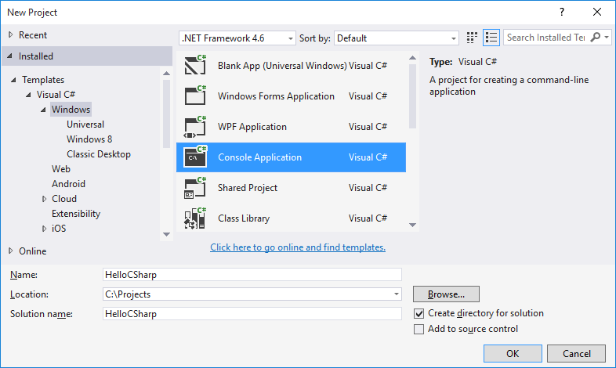
Using Visual Studio
Visual Studio (VS) is powerful IDE for C# and other languages
Create a console application

Slide 7
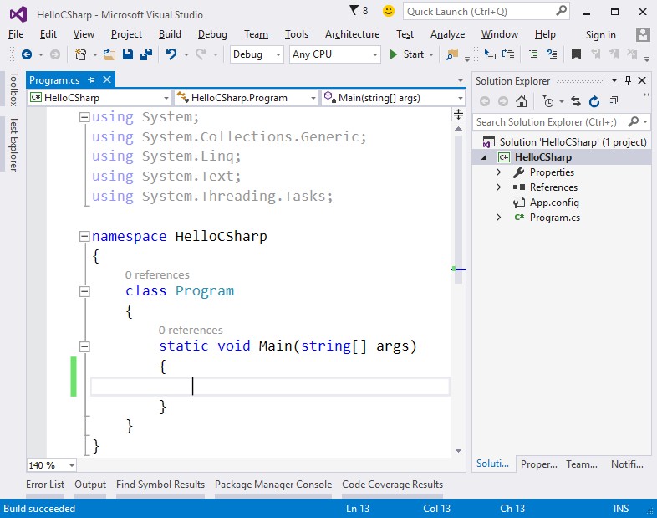
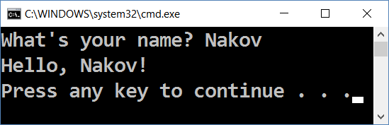
Writing Code and Running the Program
Start the program from VS using [Ctrl + F5]

Slide 8

Declaring Variables

Slide 9
Declaring Variables
To declare variables in C# you need to use the pattern:
Examples:
Type is inferred from the right side of the expression (use var)
{data type / var} {variable name} = {value};
var firstNumber = 5;
var name = "Pesho";
var isPassed = false;
var gender = 'F';
var mathGrade = 5.49;
int firstNumber = 5;
string name = "Pesho";
bool isPassed = false;
char gender = 'F';
double mathGrade = 5.49;

Slide 10

Console I/O
Reading from and Writing to the Console

Slide 11
Reading from the Console
We can read/write to the console, using the Console class
Use the System namespace to access System.Console class
Reading input from the console using Console.ReadLine():
using System;
var name = Console.ReadLine();
Returns string

Slide 12
Converting Input from the Console
Console.ReadLine() returns a string
Convert the string to number by parsing:
var name = Console.ReadLine();
var age = int.Parse(Console.ReadLine());
var salary = double.Parse(Console.ReadLine());

Slide 13
Printing to the Console
We can print to the console, using the Console class
Use the System namespace to access System.Console class
Writing output to the console using Console.WriteLine():
Prints Gosho
var name = "Gosho";
Console.WriteLine(name);

Slide 14
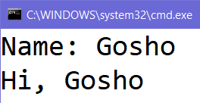
Printing on the Same Line
Sometimes, we want to print text on the same line
Use Console.Write():
Console.Write("Name: ");
var name = Console.ReadLine();
Console.WriteLine("Hi, " + name);

Slide 15
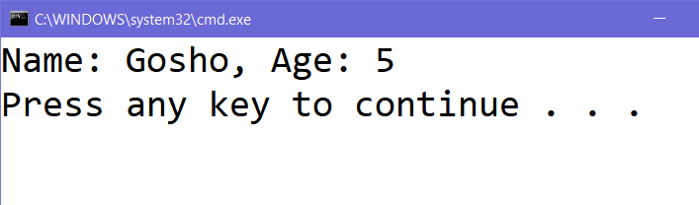
Printing on the Console
Use string concatenation to print text with numbers
Or the {0} placeholders
Or the ${variable} syntax
var name = "Gosho";
var age = 5;
Console.WriteLine("Name: " + name + ", Age: " + age);
Console.WriteLine("Name: {0}, Age: {1}", name, age);
Console.WriteLine($"Name: {name}, Age: {age}");

Slide 16
Problem: Greeting
Write a C# program, which greets the user by name:
Pesho
Hello, Pesho!
Ivan
Hello, Ivan!
Merry
Hello, Merry!
Check your solution here: https://judge.softuni.bg/Contests/559

Slide 17
Solution: Greeting
Read name from the console and print it:
using System;
static void Main()
{
var name = Console.ReadLine();
Console.WriteLine("Hello, " + name + "!");
}

Slide 18
Using Placeholders
Using placeholders to print at the console:
Placeholder {0} corresponds to name
Placeholder {0} corresponds to name
var name = "Gosho";
var age = 5;
Console.WriteLine("Name: {0}, Age: {1}", name, age);

Slide 19
Problem: Add Two Numbers
Write a C# program to read two integers and add them together. Print the sum like shown at the examples:
2
5
2 + 5 = 7
1
3
1 + 3 = 4
-3
5
-3 + 5 = 2

Slide 20
Solution: Add Two Numbers
Read the integers from the console, sum and print them:
var a = int.Parse(Console.ReadLine());
var b = int.Parse(Console.ReadLine());
var sum = a + b;
Console.WriteLine("{0} + {1} = {2}", a, b, sum);
Check your solution here: https://judge.softuni.bg/Contests/559

Slide 21
Using String Interpolation
Using string interpolation to print at the console:
Put $ in front of "" to use string interpolation
var name = "Gosho";
var age = 5;
Console.WriteLine($"Name: {name}, Age: {age}");

Slide 22
Formatting Numbers in Placeholders
D – format number to certain digits with leading zeros
F – format floating point number with certain digits after the decimal point
Examples:
var grade = 5.5334;
var percentage = 55;
Console.WriteLine("{0:F2}", grade); // 5.53
Console.WriteLine("{0:D3}", percentage); // 055

Slide 23
Problem: Employee Data
Write a C# program, which reads employee information and prints them, formatted like shown below:
Ivan
24
1192
1500.353
Name: Ivan
Age: 24
Employee ID: 00001192
Salary: 1500.35

Slide 24
Solution: Employee Data
Read the data from the console and format it:
var name = Console.ReadLine();
var age = int.Parse(Console.ReadLine());
var employeeId = int.Parse(Console.ReadLine());
var salary = double.Parse(Console.ReadLine());
Console.WriteLine($"Name: {name}");
Console.WriteLine($"Age: {age}");
Console.WriteLine($"Employee ID: {employeeId:D8}");
Console.WriteLine($"Salary: {salary:F2}");
Check your solution here: https://judge.softuni.bg/Contests/559

Slide 25
C# Basic Syntax
Live Exercises in Class (Lab)

Slide 26



Summary
Declare variables is C# using var
Read input from the console using Console.ReadLine() → string
Convert input to numbers by parsing, e.g. int.Parse(str), double.Parse(str)
Print to the console using Console.Write() and Console.WriteLine()
Use concatenation +, placeholders {0} and string interpolation $"text {variable}"

Slide 27







Programming Fundamentals – C# Introduction
https://softuni.bg/courses/programming-fundamentals

Slide 28
License
This course (slides, examples, demos, videos, homework, etc.) is licensed under the "Creative Commons Attribution-NonCommercial-ShareAlike 4.0 International" license

Slide 29





Trainings @ Software University (SoftUni)
Software University – High-Quality Education, Profession and Job for Software Developers
softuni.bg
Software University Foundation
http://softuni.foundation/
Software University @ Facebook
facebook.com/SoftwareUniversity
Software University Forums
forum.softuni.bg

